Slide 1
JAVA Lecture 9
String Constructors and Length

Slide 2
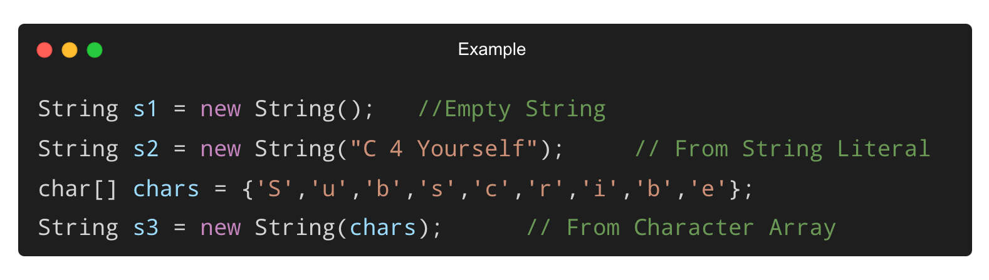
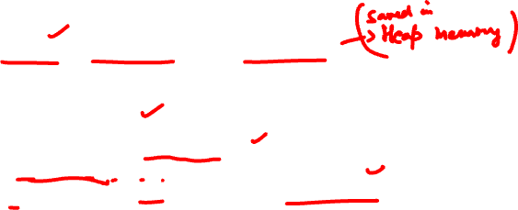
Creating Strings Using Constructors
String objects can be created using constructors.

Slide 3
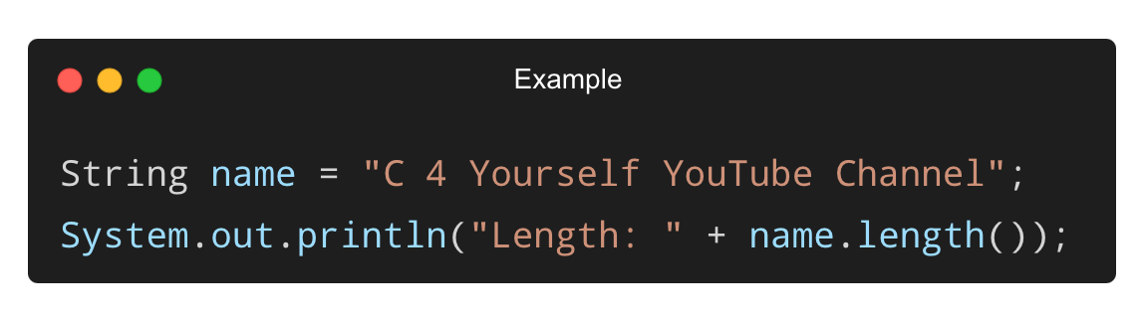

String Length – length() Method
Returns the number of characters in a string (including spaces).
Output:
Length: 28

Slide 4
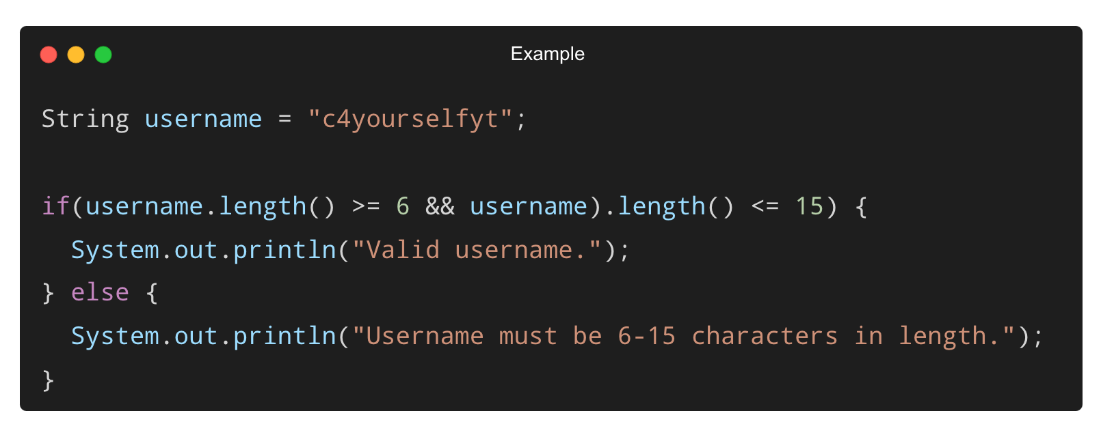

Using length() in Real-World Applications
Checking if a username meets length requirements:
Output:
Valid username.

Slide 5
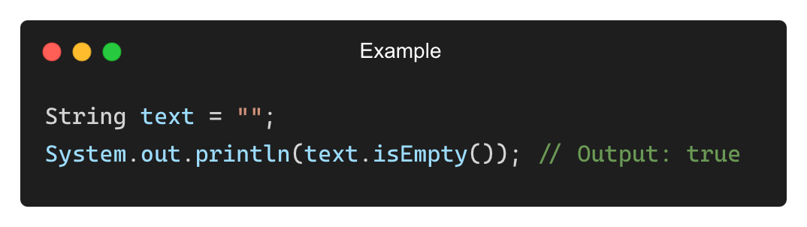
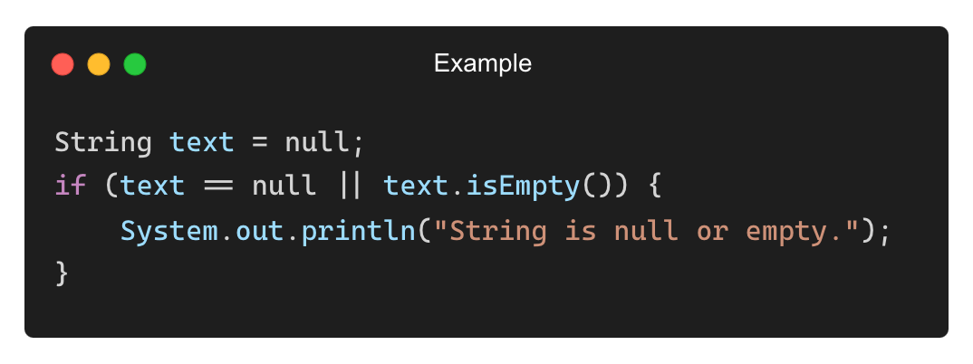
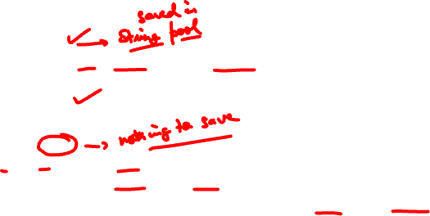
Handling Empty and Null Strings
Checking if a String is Empty (isEmpty()):
Checking for Null Strings:
Output:
String is null or empty.

Slide 6
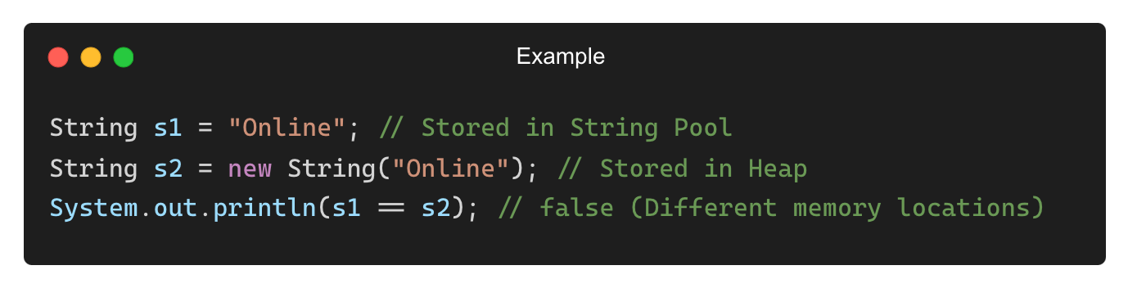

String Memory Management (Heap vs. String Pool)
Method | Memory Type | Usage
String s = “Aditya” | String Pool | Efficient, reuses memory
String s = new String(“Aditya”) | Heap | Creates new memory allocation
Output:
false

Slide 7
THANK YOU

